Slide 1
Transport
In Plants

Slide 2
The Structure and Function of Transport systems in Plants
In higher plants transport is carried out by vascular tissue
Vascular tissue consist of
Xylem and
Phloem
It is found in the roots, stems and leaves

Slide 3
Distribution of Vascular Tissue in a Dicotyledonous Plant
Draw transverse (or cross) sections of the vascular system found in a dicot
Leaf
Stem
Root

Slide 4
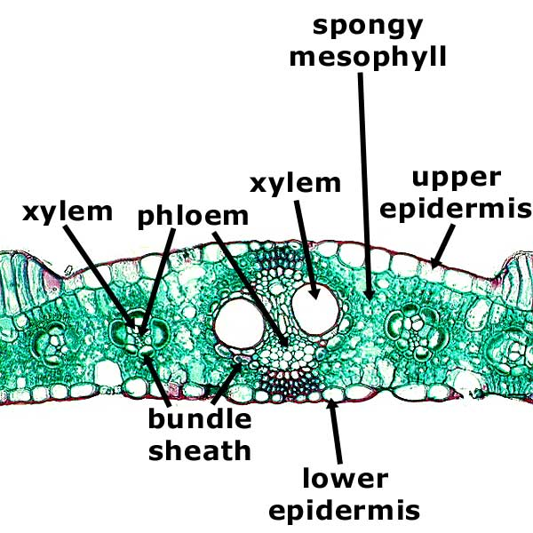
Cross Section of a Leaf

Slide 5
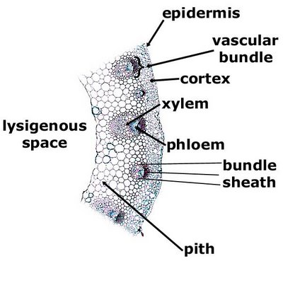
Cross section of a Stem

Slide 6
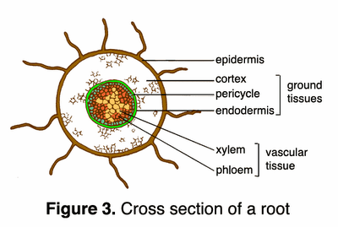

Slide 7
Xylem
A conducting tissue made up of conducting elements called vessels.
Xylem vessels are DEAD
They are long hollow tubes which are from form columns of elongated cells whose end walls have broken down and whose cell contents have died.

Slide 8
Xylem
They are narrow and have walls that are strengthened by a hard substance called LIGNIN (material of which wood is made)
Xylem vessels carry water and mineral salts upwards in the plant
They also provide support for the plant.

Slide 9
Xylem vessels are adapted to carry out their function in several ways:
Structure | Function
Cells are dead and have no contents Vessels have no cross walls Vessels made of elongated narrow elements | Allow water to flow freely
Lignified walls | Able to withstand suction pressures without collapsing; Supports stems and leaves

Slide 10
Drawing exercise:
Draw the structure of a xylem vessel
i) a longitudinal section
ii) a transverse or cross section

Slide 11
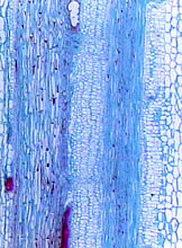
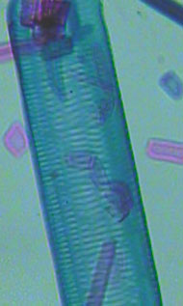
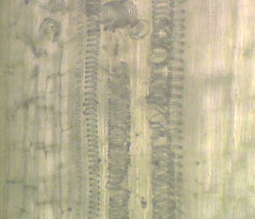
Xylem Vessels

Slide 12
Phloem
A complex tissue consisting of different types of specialized cells.
Unlike xylem it is living tissue and has no lignin in the cell walls.

Slide 13
Phloem
Each conducting cell is tubular and is called a SIEVE TUBE ELEMENT
These are joined end to end to form sieve tubes
Their ends are perforated.
They are living, but have no nucleus
They also possess few organelles and little cytoplasm which surrounds a very large vacuole
Sieve tubes conduct manufactured food

Slide 14
Phloem
Specialized cells called COMPANION CELLS are closely associated with the sieve tubes.
Each contains a nucleus, numerous mitochondria and other organelles that are largely absent from the sieve tubes.
It is thought that these cells carry out the normal cell processes for the sieve tubes and supply energy for conduction

Slide 15
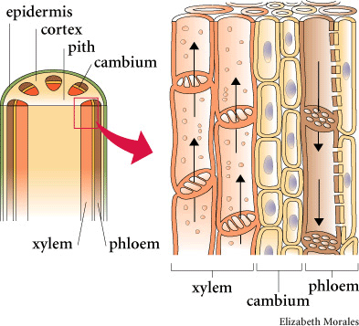

Slide 16
Phloem transports…
Manufactured food in the cell sap.
These include:
Sugars (mainly sucrose)
Amino acids
Other nutrient compounds
These are made from the products of photosynthesis and moved throughout the plant to growing points or to certain areas for storage (roots, fruits, etc)

Slide 17
Phloem…
Food can also be moved from storage areas to areas of need
e.g. from cotyledons of germinating seeds to the young roots and shoots.
This movement of food is called TRANSLOCATION and occurs in the sieve tubes

Slide 18
Phloem…
Translocation requires energy from respiration, which is unlike transport of water and minerals through xylem vessels.
Evidence that pointed to phloem as the food conducting tissue:
Ringing experiments: if a ring of bark and phloem is removed around a woody stem, sugars accumulate above the ring causing a slightly swollen appearance.

Slide 19
Vascular bundle
A group of phloem and xylem tissues together make up a vascular bundle.
Vascular bundles are arranged differently in roots and stems.
Draw a cross section of a dicot root and shoot

