Slide 1
Transport
In Plants

Slide 2
Importance of transportation
Complex multicellular organisms depend on other parts to provide resources for complete function. Division of Labour.
Structures in plants that are involved in transport are structures that have the means of distributing substances.
What are the characteristics that a structure would need to have in order to transport substances from one place to the next?

Slide 3
Transport Structures
Xylem
Phloem
Vascular bundles (which contain the xylem and the phloem)
Veins (which contain the xylem and phloem)
Arrangement of these structures is also significant with regard to where the substances are coming from and where they are going
Arrangement of vascular bundle in root of dicot, in monocot, in stem, then in leaves

Slide 4
Transport Process
Processes that cause the movement of substance through these vessels
Transpiration (water through plant)
Root pressure
Capillarity
Evaporation
Translocation (food through the plant)

Slide 5
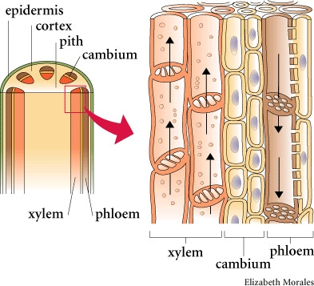
Structure of Xylem Woody, Dead

Slide 6
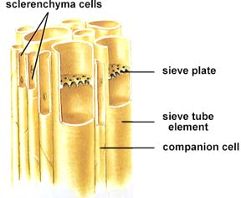
Structure of Phloem Living, Companion cell, Not woody

Slide 7
Homework
Describe the process of water movement through a plant.
Key words: root pressure, osmosis, capillarity, transpiration pull, evaporation, xylem, roots, soil, water vapour, vascular bundle, adhesion, cohesion, root hairs
Use a diagram to fully illustrate the process

Slide 8
Factors that Affect Transpiration Rate
Temperature
Humidity
Air movement (wind)
Light intensity
For each of the above factors, write one paragraph describing how the affect the rate of transpiration

Slide 9
Conservation of Water in Plants
Types of plants classified according to its adaptations to conserve water:
Xerophytes
Mesophytes
Hydrophytes
Halophytes
Structures adapted
Leaves, stems

