Slide 1
Respiratory Surfaces
Making a Model of the Lungs

Slide 2
Materials
Clear plastic bottle, such as a 2 liter bottle
Cork stopper that will fit the mouth of the bottle. This cork should have a hole through it.
Small tube that will fit the hole in the cork
Large balloon
A large piece of broken balloon. A used party balloon works well for this.
Tape -Wide clear packing tape works the best.

Slide 3
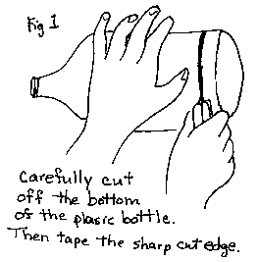
Instructions
(Fig.1) Carefully cut the bottom off of the plastic bottle. Put tape all around the bottom, covering the sharp edge. This is to protect the balloon that you will attach later. Insert the tube into the cork so that the tube sticks out on both ends.

Slide 4
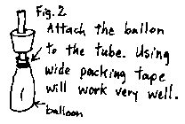
(Fig 2) Attach the balloon to the tube using tape. Make sure it is completely sealed. To test it, try blowing up the balloon.
The balloon represents a lung. There are no muscles in the lungs.
*If you can get the mouth of the balloon over the mouth of the bottle, then you will not need the cork.

Slide 5
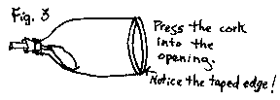
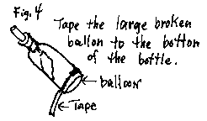
(Fig. 3) Put the cork into the mouth of the plastic bottle. Make sure it is tight.
(Fig. 4) Tape the large broken balloon to the bottom of the plastic bottle. Make sure it is air tight!
This balloon represents the large muscle that is beneath the lungs (the diaphragm).

Slide 6
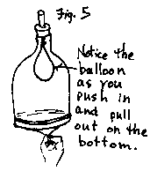
(Fig. 5) Push and pull on the balloon (slowly) to see how it works. If you have trouble catching hold of the balloon, put a small piece of tape on the center of the balloon to make a handle.

