Slide 1
Cell Structure
Components structure and function

Slide 2
Endoplasmic Reticulum
Smooth and Rough ER

Slide 3
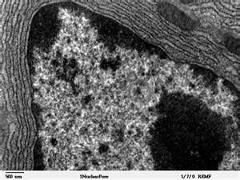
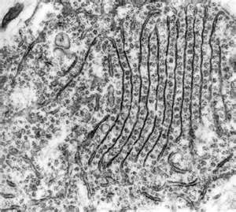
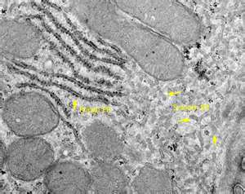
Notes:
Cannot be seen under the light microscope
Appears as pairs of parallel lines (membranes)
Tend to be sheet like and not tubular in 3D (see Biological Science p.159 Fig 5.26)

Slide 4
Endoplasmic Reticulum
Extensive membrane system which runs through the cytoplasm
Much of the ER has ribosomes attached to it which is called Rough ER
Smooth ER do not have ribosomes attached
SER and RER have different functions
RER – transports proteins made by ribosomes
SER – makes lipids and steroids (cholesterol & reproductive hormones)
The membranes form a system of flattened sacs, like sheets called cisternae
The space inside the sacs forms a compartment separate from the surrounding cytoplasm

Slide 5
ER cont’d
ER is continuous with the nuclear envelope
The cisternae goes on to form the Golgi apparatus
RER tends to be sheet-like
SER tends to be tubular
SER has different roles in different cells
RER tends to be extensive in cells which produce a lot of protein (enzyme-secreting cells in the digestive system)
RER gives more surface area for protein synthesis, storage (Ca) and transportation
Notes:
Ovary (steroids like oestrogen and testosterone)
Liver cells (toxins are broken down and make harmless)
Epithelium of intestine (makes lipids from fatty acids and glycerol absorbed from the gut passing them to Golgi bodies for export)
Adrenal cortex (corticosteroids)
Muscle cells (specialised SER called sarcoplasmic reticulum)

Slide 6
Ribosomes
Sites of Protein Synthesis

Slide 7
Ribosomes
There are 2 types
70S (found in prokaryotes, chloroplasts and mitochondria)
80S (found in eukaryotes)
They are very small organelles
Consist of 2 units (see BS P. 150)
Made of RNA (ribonucleic acid) and protein
May form polysomes which is a collection of ribosomes strung along mRNA

Slide 8
Ribosomes cont’d
Sites for protein synthesis
Found free in the cytoplasm as well as on the RER.
Proteins that are manufactured on the ribosomes are transported throughout the cell by RER
Notes:
As protein are made in the ribosomes, they are collected in the cisternae and transported to other areas in the cell (via the Golgi apparatus)
As the protein is made, it remains bound to the ribosomes until its synthesis is complete (ribosomes act as a binding site). A receptor in the membrane of the ER provides a channel through which the protein can pass into the ER once it has been made.
As the protein is transported through the cisternae, it can get modified (can be converted to glycoprotein)
The proteins made will then be transported by the Golgi bodies to other organelles of the cell or secreted from the cell
The RNA that makes up ribosomes is called rRNA which is made in the nucleoli of the nucleus
As proteins are being made along the mRNA, the process is made more efficient by a number of ribosomes moving along the mRNA at the same time like beads on a string – these are the polyribosomes or polysomes

Slide 9
Ribosomes cont’d
Proteins made by ER bound ribosomes tend to be secreted from the cell.
Haemoglobin is an example of a protein made by free ribosomes in the cytoplasm in young RBC
Enzymes involved in glycolysis (1st stage in respiration)

Slide 10
Quick Question!
List 4 functions of ER
To form an extensive transport system throughout the cell (connecting nuclear envelope to cell membrane structure
Production and packaging of proteins (RER)
Synthesis of lipids and steroids (SER)
Collection, storage and distribution of these materials
Notes:
Functions of ER:
To form an extensive transport system throughout the cell (connecting nuclear envelope to cell membrane structure
Production and packaging of proteins (RER)
Synthesis of lipids and steroids (SER)
Collection, storage and distribution of these materials

Slide 11
Mitochondrion
Powerhouse of the Cell

Slide 12
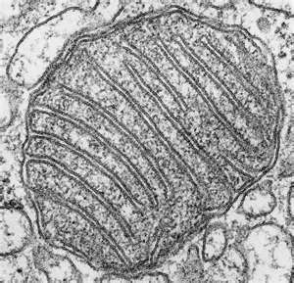
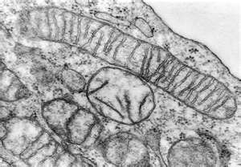
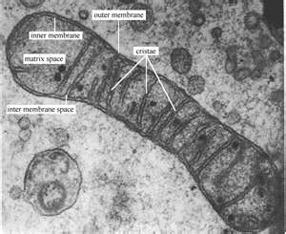
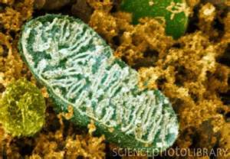

Slide 13
Mitochondria
Surrounded by 2 membranes (an envelope)
The inner forms the cristae (finger like projections)
The interior is filled with a fluid or matrix
Main function:
To carry out the later stages of aerobic respiration (make ATP)
Another function is to make lipids
Contained in cells which require a lot of energy
The membrane of the mitochondria is the site of ATP synthesis
The matrix of the mitochondria is the site for the Kreb’s cycle

Slide 14
Mitochondria cont’d
The number of mitochondria found in cells depends on the type of organism and the nature of the cell
Their shapes and sizes vary from
Spiral
Spherical
Elongated
Cup-shaped
Branched
Length range from 1.5-10 micrometer but diameter does not exceed 1 micrometer

Slide 15
Mitochondria cont’d
Contains 70S ribosomes
Contains circular DNA
Able to change shape
Able to move to areas in the cell where a lot of activity is taking place
Some can remain fixed (insect flight muscle)
See BS p. 276 for further details on structure of mitochondria

Slide 16
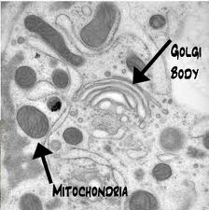
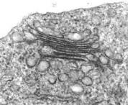
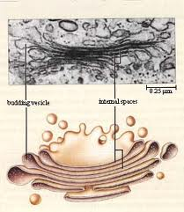
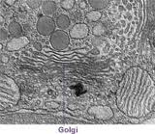

Slide 17
Golgi Body/Apparatus
A series of flattened membrane vesicles
Formed from the endoplasmic reticulum
Transports proteins from the RER to the cell membrane for export
Part of the RER containing proteins fuse with one side of the Golgi body membranes
The point at which fusion occurs their contents are released via exocytosis

Slide 18
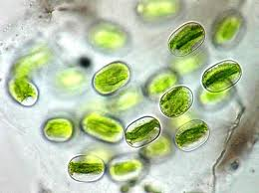
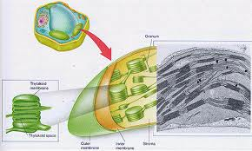
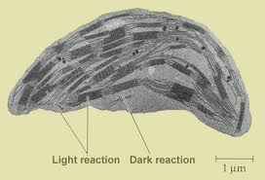
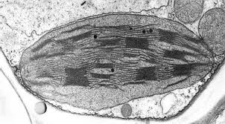

Slide 19
Chloroplast
Bigger and fatter than mitochondria
Site of photosynthesis
Found in photosynthetic organisms (plant & algae)
Enclosed in a double membrane
Thylakoid membranes are folded into thylakoid disks
Stacked into piles of grana
The space between the inner membrane and the thylakoid is called the stroma
Thylakoid membranes contain chlorophyll and stalk elements

Slide 20
Chloroplasts cont’d
Thylakoids are the site of photosynthesis and ATP synthesis
Chloroplasts also contain
starch grains
Ribosomes
Circular DNA

Slide 21
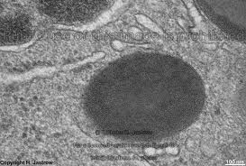
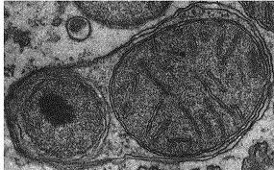
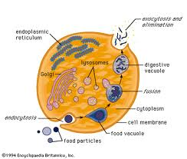
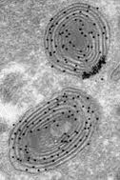
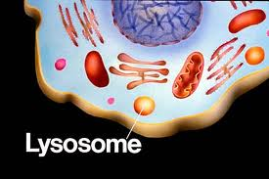

Slide 22
Lysosomes
Small membrane-bound vesicles
Formed from RER containing a cocktail of digestive enzymes
Break down unwanted chemicals, toxins, organelles or even whole cells - recycling materials
Can fuse with a feeding vacuole to digest its contents

Slide 23
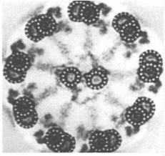
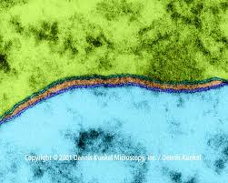
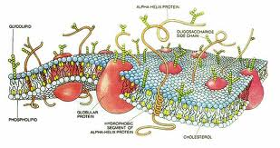
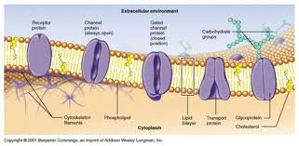

Slide 24
Cell membrane
Also called plasma membrane or cell surface membrane
Thin & flexible
Found around the outside of all cells
Made of phospholipids, proteins and carbohydrates arranges in a fluid mosaic structure
Separates the contents of the cell from the outside environment
Controls the entry and exit of materials

Slide 25
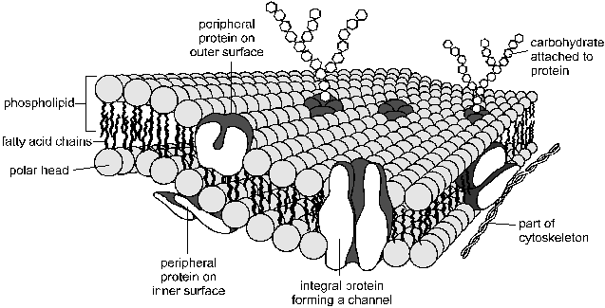

Slide 26
Cell membrane cont’d
Responsible for many properties of the cell
Membranes that surround the nucleus and other organelle are almost identical to the cell membrane

Slide 27
Phospholipids
The phospholipids are arranged in a bilayer,
polar, hydrophilic phosphate heads facing outwards,
non-polar, hydrophobic fatty acid tails facing each other in the middle of the bilayer.

Slide 28
This hydrophobic layer acts as a barrier to all but the smallest molecules
effectively isolating the two sides of the membrane.
Different kinds of membranes can contain phospholipids with different fatty acids, affecting the
strength and
flexibility of the membrane,
Animal cell membranes also contain cholesterol linking the fatty acids together and so stabilising and strengthening the membrane.

Slide 29
The Proteins
usually span from one side of the phospholipid bilayer to the other (intrinsic proteins),
but can also sit on one of the surfaces (extrinsic proteins).
They can slide around the membrane very quickly and collide with each other, but can never flip from one side to the other.
have hydrophilic amino acids in contact with the water on the outside of membranes, and hydrophobic amino acids in contact with the fatty chains inside the membrane.
comprise about 50% of the mass of membranes, and are responsible for most of the membrane's properties.

Slide 30
Proteins cont’d
Proteins that span the membrane are usually involved in transporting substances across the membrane
Proteins on the inside surface of cell membranes are often attached to the cytoskeleton and are involved in maintaining the cell's shape, or in cell motility.
They may also be enzymes, catalysing reactions in the cytoplasm.

Slide 31
Proteins cont’d
Proteins on the outside surface of cell membranes can act as receptors by having a specific binding site where hormones or other chemicals can bind.
This binding then triggers other events in the cell.
They may also be involved in cell signalling and cell recognition, or
they may be enzymes, such as maltase in the small intestine (more in digestion).

Slide 32
Carbohydrates
found on the outer surface of all eukaryotic cell membranes,
are usually attached to the membrane proteins.
Proteins with carbohydrates attached are called glycoproteins.
The carbohydrates are short polysaccharides composed of a variety of different monosaccharides, and form a cell coat or glycocalyx outside the cell membrane.
The glycocalyx is involved in protection and cell recognition, and antigens such as the ABO antigens on blood cells are usually cell-surface glycoproteins.

Slide 33
Nucleus
This is the largest organelle.
Surrounded by a nuclear envelope, which is a double membrane with nuclear pores - large holes containing proteins that control the exit of substances such as RNA from the nucleus.
Notes:
----- Meeting Notes (10/7/11 11:12) -----
granular appearance only visible under electron

Slide 34
Nucleus cont’d
The interior is called the nucleoplasm, which is full of chromatin- a DNA/protein complex containing the genes.
During cell division the chromatin becomes condensed into discrete observable chromosomes.
The nucleolus is a dark region of chromatin, involved in making ribosomes.

Slide 35
Cytoskeleton
This is a network of protein fibres extending throughout all eukaryotic cells, used for support, transport and motility
The cytoskeleton is attached to the cell membrane and gives the cell its shape, as well as holding all the organelles in position
There are three types of protein fibres (microfilaments, intermediate filaments and microtubules), and each has a corresponding motor protein that can move along the fibre carrying a cargo such as organelles, chromosomes or other cytoskeleton fibres

Slide 36
Cytoskeleton
These motor proteins are responsible for such actions as: chromosome movement in mitosis, cytoplasm cleavage in cell division, cytoplasmic streaming in plant cells, cilia and flagella movements, cell crawling and even muscle contraction in animals.

Slide 37
Summary of the Differences Between Prokaryotic and Eukaryotic Cells

Slide 38
Endosymbiosis
Prokaryotic cells are far older and more diverse than eukaryotic cells. Prokaryotic cells have probably been around for 3.5 billion years - 2.5 billion years longer than eukaryotic cells.
It is thought that eukaryotic cell organelles like mitochondria and chloroplasts are derived from prokaryotic cells that became incorporated inside larger prokaryotic cells.

Slide 39
Endosymbiosis
This idea is called endosymbiosis, and is supported by these observations:
organelles contain circular DNA, like bacteria cells.
organelles contain 70S ribosomes, like bacteria cells.
organelles have double membranes, as though a single-membrane cell had been engulfed and surrounded by a larger cell.

Slide 40
Transport Across The Membrane
Cell membranes are a barrier to most substances, and this property allows materials to be concentrated inside cells, excluded from cells, or simply separated from the outside environment.
This is compartmentalization is essential for life, as it enables reactions to take place that would otherwise be impossible. Eukaryotic cells can also compartmentalize materials inside organelles.

Slide 41
Materials need to be able to enter and leave cells
There are five main methods by which substances can move across a cell membrane:
1. Simple Diffusion
2. Osmosis
3. Facilitated Diffusion
4. Active Transport
5. Vesicles

Slide 42
Simple Diffusion

Slide 43
A few substances can diffuse directly through the lipid bilayer part of the membrane.
The only substances that can do this are lipid-soluble molecules such as steroids, or very small molecules, such as H₂O, O₂ and CO₂.
For these molecules the membrane is no barrier at all.
Since lipid diffusion is (obviously) a passive diffusion process, no energy is involved and substances can only move down their concentration gradient.
Lipid diffusion cannot be controlled by the cell, in the sense of being switched on or off.

Slide 44
Osmosis

Slide 45
Osmosis
Osmosis is the diffusion of water across a membrane.
It is in fact just normal lipid diffusion, but since water is so important and so abundant in cells (its concentration is about 50 M), the diffusion of water has its own name - osmosis.
The contents of cells are essentially solutions of numerous different solutes, and the more concentrated the solution, the more solute molecules there are in a given volume, so the fewer water molecules there are.
Water molecules can diffuse freely across a membrane, but always down their concentration gradient, so water therefore diffuses from a dilute to a concentrated solution.

Slide 46
Osmosis

Slide 47
Water Potential
Osmosis can be quantified using water potential, so we can calculate which way water will move, and how fast.
Water potential (Y, the Greek letter psi, pronounced "sy") is a measure of the water molecule potential for movement in a solution.
It is measured in units of pressure (Pa, or usually kPa), and the rule is that water always moves by osmosis from less negative to more negative water potential (in other words it's a bit like gravity potential or electrical potential).
100% pure water has Y = 0, which is the highest possible water potential, so all solutions have Y < 0 (i.e. a negative number), and you cannot get Y > 0.

Slide 48
Cells and Osmosis
The concentration (or OP) of the solution that surrounds a cell will affect the state of the cell, due to osmosis. There are three possible concentrations of solution to consider:
Isotonic solution a solution of equal OP (or concentration) to a cell
Hypertonic solution a solution of higher OP (or concentration) than a cell
Hypotonic solution a solution of lower OP (or concentration) than a cell

Slide 49
The effects of these solutions on cells are shown in this diagram:

Slide 50
Notes:
The diagram below shows what happens when 2 fresh raw eggs with their shells removed with acid are placed into sucrose solution (hypertonic) and distilled water (hypotonic). Water enters the egg in water (endosmosis) causing it to swell and water leaves the egg in sucrose causing it to shrink (exosmosis).

Slide 51
Problems living cells face
Simple animal cells (protozoans) in fresh water habitats are surrounded by a hypotonic solution and constantly need to expel water using contractile vacuoles to prevent swelling and lysis.
Cells in marine environments are surrounded by a hypertonic solution, and must actively pump ions into their cells to reduce their water potential and so reduce water loss by osmosis.
Young non-woody plants rely on cell turgor for their support, and without enough water they wilt. Plants take up water through their root hair cells by osmosis, and must actively pump ions into their cells to keep them hypertonic compared to the soil. This is particularly difficult for plants rooted in salt water.

Slide 52
Facilitated Diffusion

Slide 53
Facilitated diffusion is the transport of substances across a membrane by a trans-membrane protein molecule.
The transport proteins tend to be specific for one molecule (a bit like enzymes), so substances can only cross a membrane if it contains the appropriate protein.
As the name suggests, this is a passive diffusion process, so no energy is involved and substances can only move down their concentration gradient. There are two kinds of transport protein:
Channel Proteins form a water-filled pore or channel in the membrane. This allows charged substances (usually ions) to diffuse across membranes. Most channels can be gated (opened or closed), allowing the cell to control the entry and exit of ions.
Carrier Proteins have a binding site for a specific solute and constantly flip between two states so that the site is alternately open to opposite sides of the membrane. The substance will bind on the side where it at a high concentration and be released where it is at a low concentration.

Slide 54
The rate of diffusion of a substance across a membrane increases as its concentration gradient increases, but whereas lipid diffusion shows a linear relationship, facilitated diffusion has a curved relationship with a maximum rate. This is due to the rate being limited by the number of transport proteins.

Slide 55
Active Transport (or Pumping)

Slide 56
Active transport is the pumping of substances across a membrane by a trans-membrane protein pump molecule.
The protein binds a molecule of the substance to be transported on one side of the membrane, changes shape, and releases it on the other side.
The proteins are highly specific, so there is a different protein pump for each molecule to be transported.
The protein pumps are also ATPase enzymes, since they catalyse the splitting of ATP into ADP + phosphate (Pi), and use the energy released to change shape and pump the molecule.
Pumping is therefore an active process, and is the only transport mechanism that can transport substances up their concentration gradient.

Slide 57
The Na⁺K⁺ Pump. This transport protein is present in the cell membranes of all animal cells and is the most abundant and important of all membrane pumps

Slide 58
Vesicles
The processes described so far only apply to small molecules. Large molecules (such as proteins, polysaccharides and nucleotides) and even whole cells are moved in and out of cells by using membrane vesicles.

Slide 59
Endocytosis
The transport of materials into a cell.
Materials are enclosed by a fold of the cell membrane, which then pinches shut to form a closed vesicle.
Strictly speaking the material has not yet crossed the membrane, so it is usually digested and the small product molecules are absorbed by the methods above.
When the materials and the vesicles are small (such as a protein molecule) the process is known as pinocytosis (cell drinking), and if the materials are large (such as a white blood cell ingesting a bacterial cell) the process is known as phagocytosis (cell eating).

Slide 61
Exocytosis
The transport of materials out of a cell. It is the exact reverse of endocytosis.
Materials to be exported must first be enclosed in a membrane vesicle, usually from the RER and Golgi Body.
Hormones and digestive enzymes are secreted by exocytosis from the secretory cells of the intestine and endocrine glands.
Sometimes materials can pass straight through cells without ever making contact with the cytoplasm by being taken in by endocytosis at one end of a cell and passing out by exocytosis at the other end.

Slide 62
Summary of Membrane Transport

