Slide 1
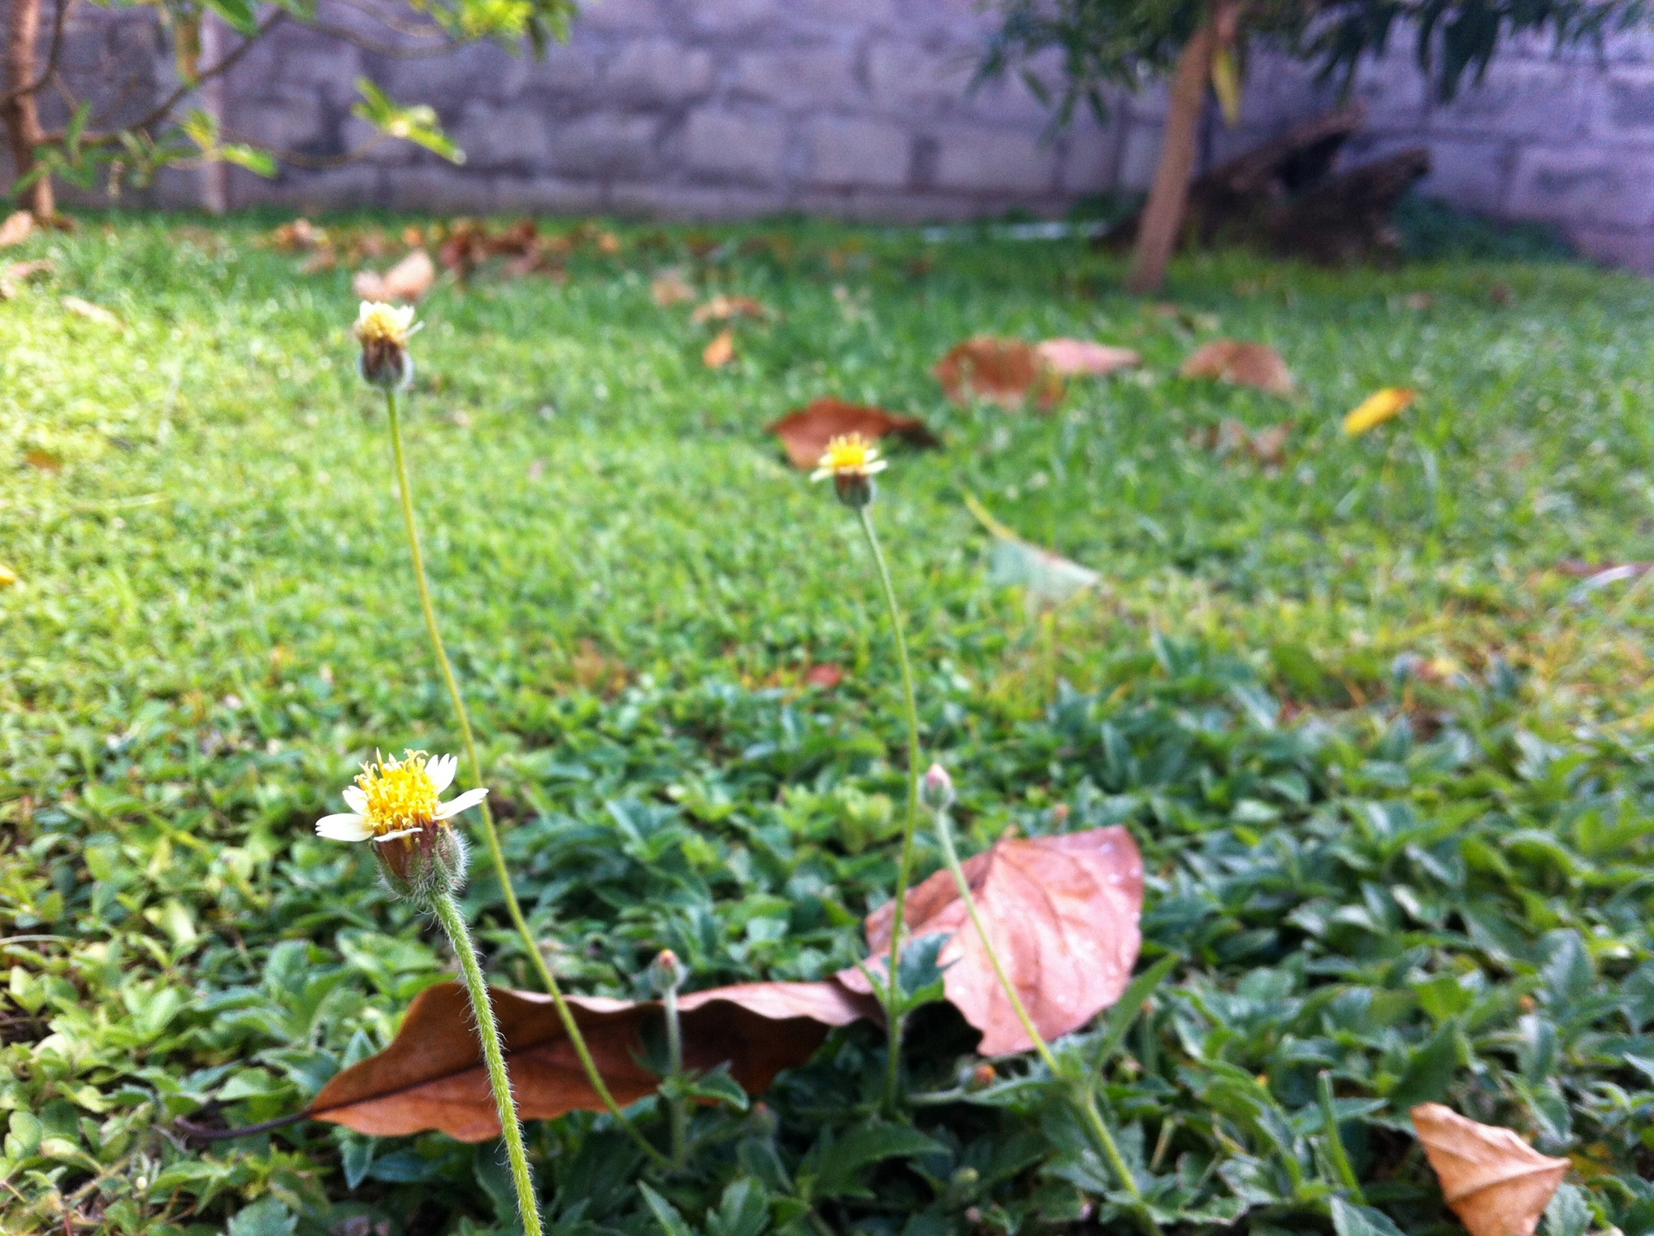
My Backyard
Biology Project
Brandon Wooding
Form 3n

Slide 2
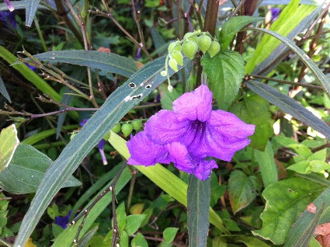
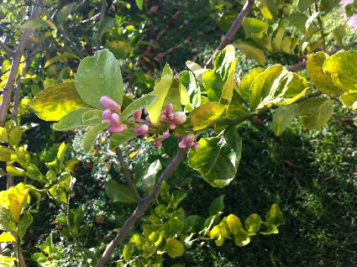
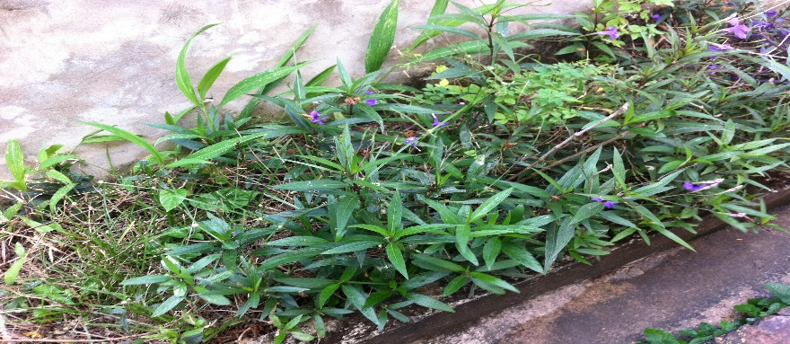
My Backyard
My Backyard is one mostly filled with young trees and herbs and a few insects. Small organisms such as birds and lizards are also sometimes spotted passing through.
Overall, the backyard is mostly human used for gardening and there is little activity from other organisms.

Slide 3
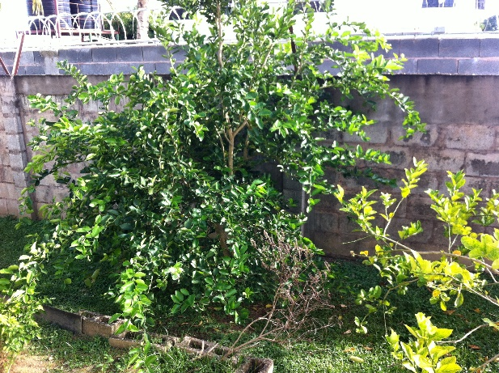
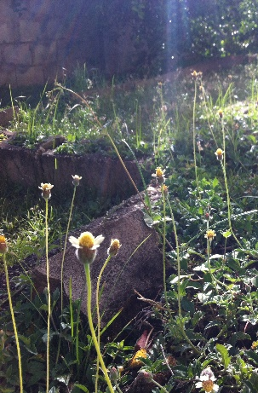
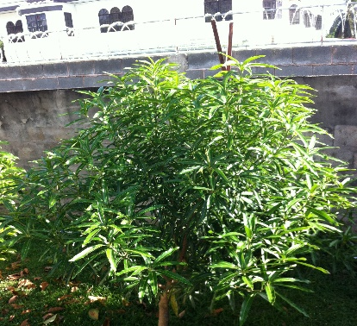
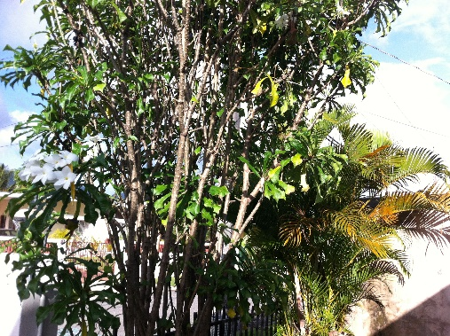
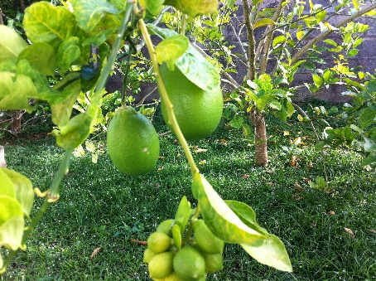
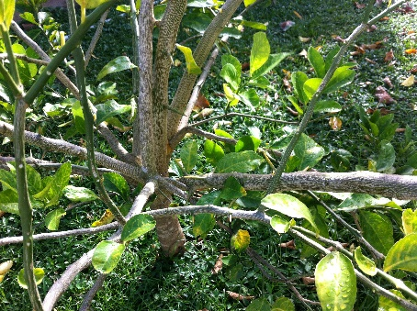
Organisms - Plants
My Backyard is full of plants and small trees. It has:
A lime tree
An Avacado Tree
A Cherry Tree
Chive roots
Parsley
Frangipani

Slide 4
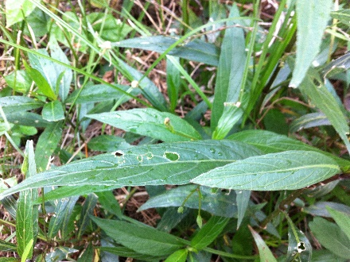
Organisms - Insects
There are many small insects which live in my Backyard and feed off of the plants and grass there. Some of these insects include flies, ants, centipedes (small) and worms.

Slide 5
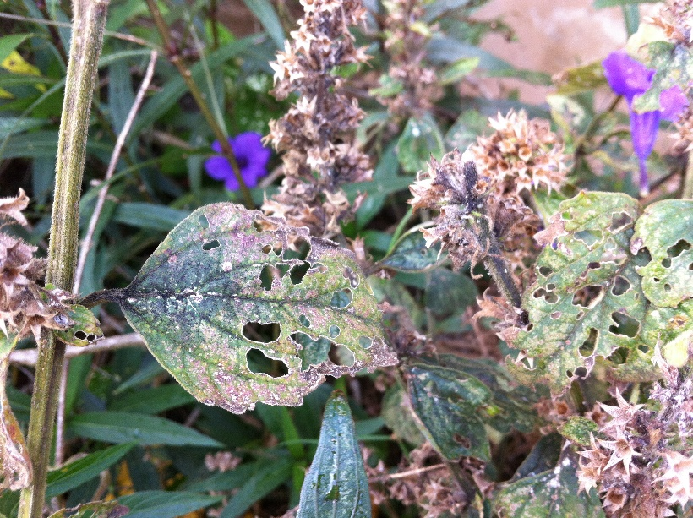
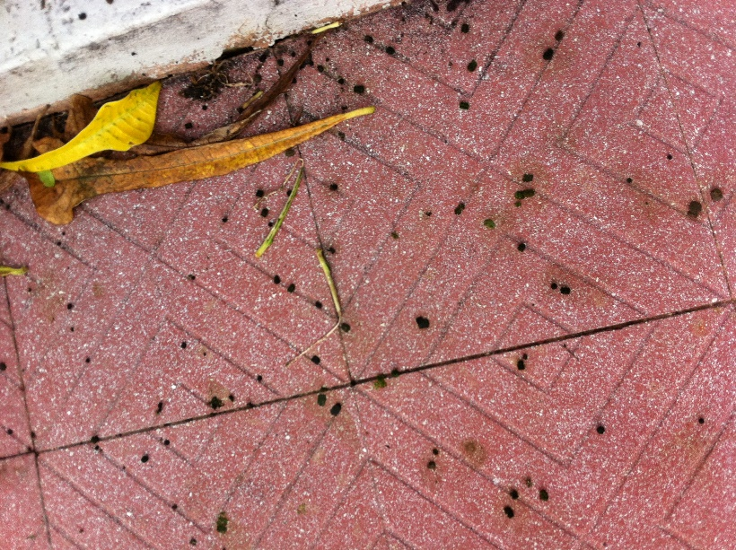
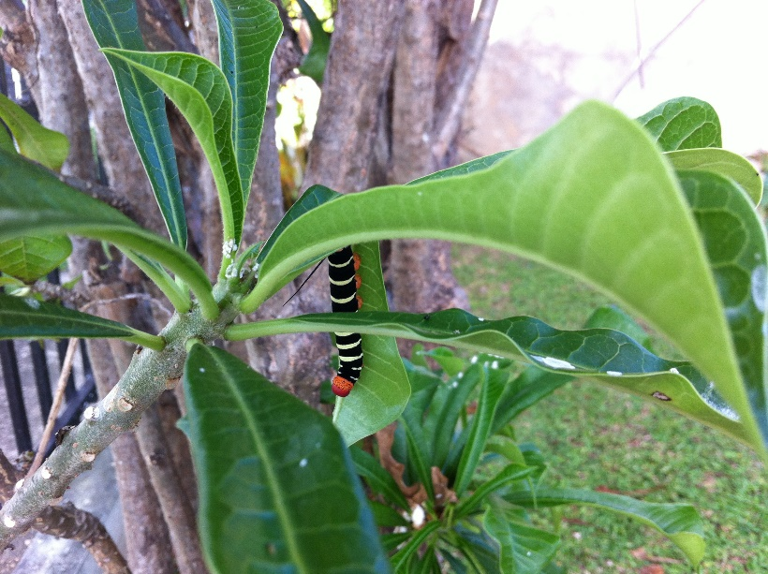
Organisms - Bug
There was also evidence and sightings of caterpillars in the yard.
Something has been eating at my leaves
And pooping all over my floor!
CATERPILLARS!

Slide 6
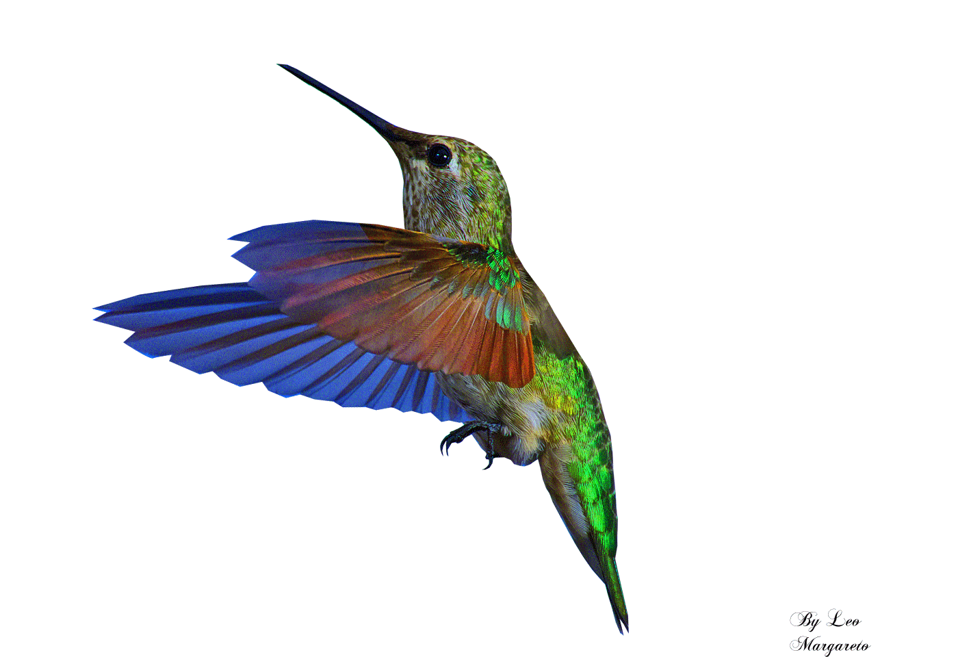
Organisms - Animals
If you listened, you could hear the tweeting of birds flying around the yard and there were hummingbirds sighted by one of the flowers. Lizards were also seen around.

Slide 7
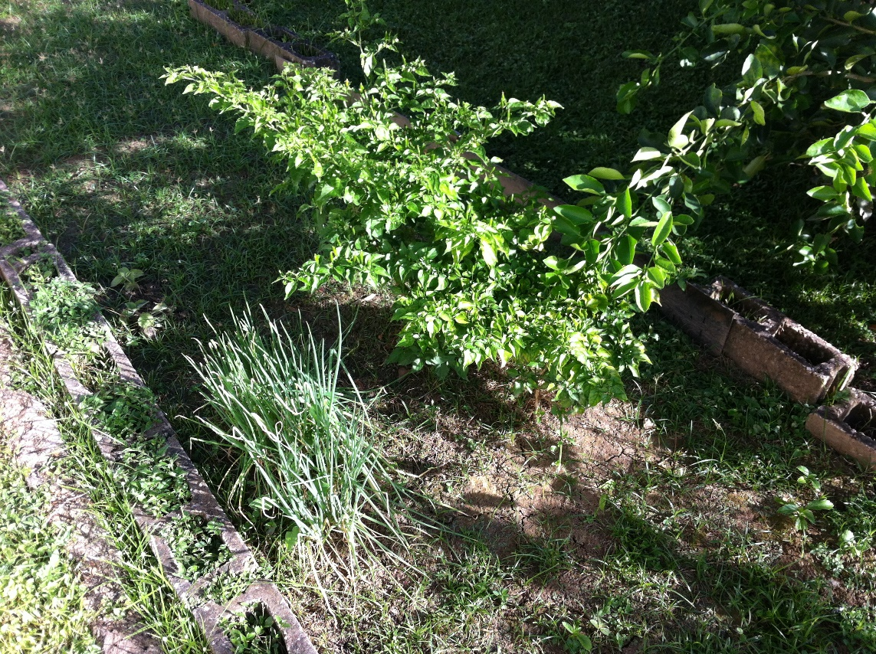
Human Influence
The whole Yard is human designed and the herbs are planted and gathered by humans. There is also a little bit of landscape work done by humans.
See the bricks here?
HUMANS!

Slide 8
Food Chains
Sun
Frangipani
Caterpillar
Kiskidee
Sun
grass
worm
Kiskidee

Slide 9
Food Chains
Sun
Grass
Ant
Lizard
Sun
Lime Tree
Flies
Lizard

Slide 10
Tertiary Consumer
Bird
(Kiskidee)
Lizard
Secondary Consumer
Caterpillar
Ants
Gnats
Primary Consumer
Producer
Frangipani
Lime Tree

Slide 11
Organisms - Commitment
Some of the organisms in My Backyard have taken up permanent residence and others pass in and out.
Committed Organisms
Un-Committed Organisms
Ants
Caterpillars*
Smaller bugs (worms etc.)
Lizards
Birds
Flies
*When the caterpillars become butterflies they leave, but if they are no longer caterpillars, the caterpillars never left, right?

Slide 12
Organisms - Commitment
The bugs which stay have no reason to leave. Everything they need in one place (food, shelter). They are in close proximity to plants (food) and there are rocks which they live under.
The organisms that come in and out probably come at certain times to take advantage of the flowers or fruits in bloom.
For example, hummingbirds are only spotted in the morning because that’s when the flower (slide 6) blooms.

